Slide 1
Sin, Salvation & Assurance
Genesis 3:1-6
Now the serpent was more crafty than any of the wild animals the LORD God had made. He said to the woman, "Did God really say, ‘You must not eat from any tree in the garden’?” The woman said to the serpent, "We may eat fruit from the trees in the garden, but God did say, ‘You must not eat fruit from the tree that is in the middle of the garden, and you must not touch it, or you will die.’“ "You will not surely die," the serpent said to the woman. "For God knows that when you eat of it your eyes will be opened, and you will be like God, knowing good and evil.“ When the woman saw that the fruit of the tree was good for food and pleasing to the eye, and also desirable for gaining wisdom, she took some and ate it. She also gave some to her husband, who was with her, and he ate it.

Slide 2
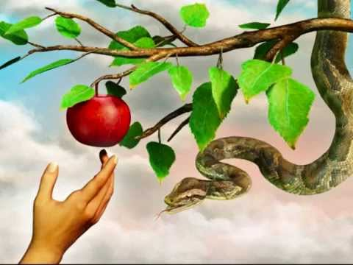
Why was just eating a little piece of fruit such a big deal?

Slide 3
It was never about the fruit at all…………..
It was all about the heart of man….
Rebelling against the one simple rule
Refusing God’s guidance
Not trusting His word to be true
Discontentment with God’s provision
Self indulgence
Sin is not so much the action that is taken, as the attitude of a heart and mind that is estranged from God and maintains a rebellious, resistant and independent attitude towards Him.

Slide 4
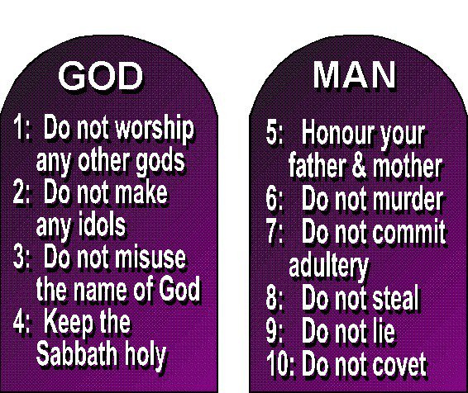
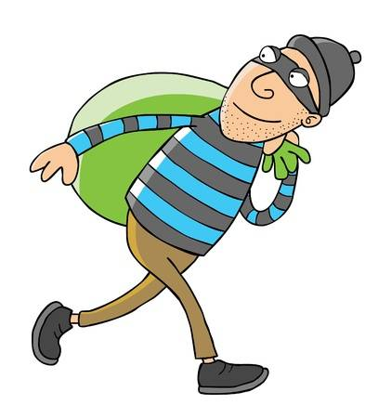
A person who steals something is-
Finding their own independent solution – refusing to trust God to provide for their needs.
Rebelling against God who said, “Do Not steal”
Depriving the neighbour that they are commanded to love

Slide 5
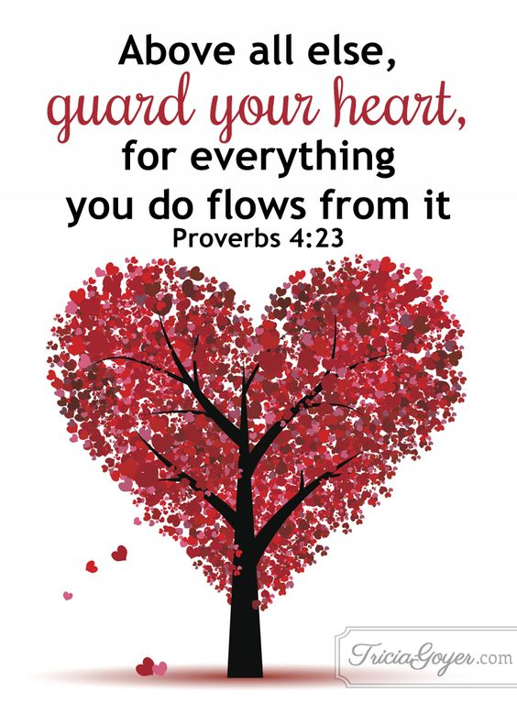
But I don’t do any of that bad stuff like stealing , murder, coveting, etc…..
for all have sinned and fall short of the glory of God, Romans 3:23
If we claim to be without sin, we deceive ourselves and the truth is not in us. 1 John 1:8
We are not sinners because we sin…..
Rather we sin because we are sinners…..
It is in our very nature – it is in our hearts

Slide 6
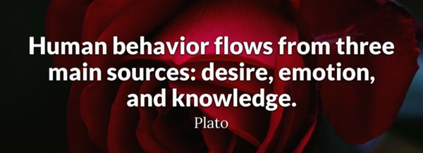
Sin is the outward act of an inner attitude
For out of the heart come evil thoughts, murder, adultery, sexual immorality, theft, false testimony, slander. These are what make a man ‘unclean’; Matthew 15:19-20
Those who live according to the sinful nature have their minds set on what that nature desires…….The mind of sinful man is death, ……the sinful mind is hostile to God. It does not submit to God’s law, nor can it do so. Romans 8:5-7

Slide 7
We just can’t stop ourselves…. or help ourselves
I know that nothing good lives in me, that is, in my sinful nature. For I have the desire to do what is good, but I cannot carry it out. For what I do is not the good I want to do; no, the evil I do not want to do—this I keep on doing…….
What a wretched man I am! Who will rescue me from this body of death? Romans 7:18-19 & 24
That’s why we need a Saviour

Slide 8
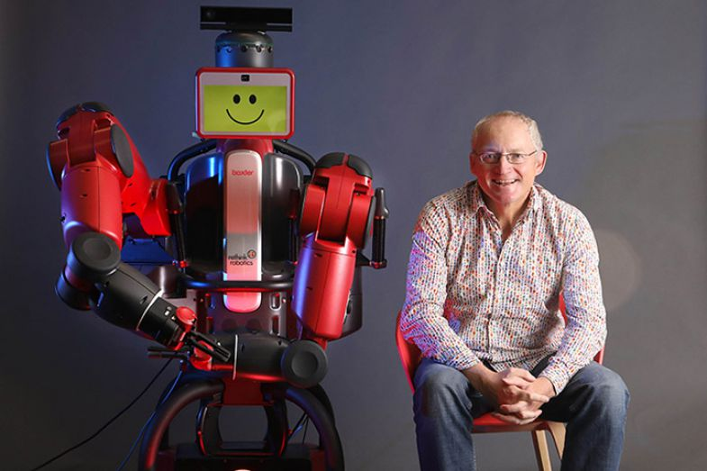
So why doesn’t God stop us and make us obey?
Because he made us to be people not robots – designed for loving relationship with Him.
With relationship comes choice and free will, as well as consequences.

Slide 9
God is NOT angry with us
God is not against us for our sin – rather God is FOR us against our sin
When Jesus saw the crowds, he had compassion on them, because they were harassed and helpless, like sheep without a shepherd. Matthew 9:36
But God demonstrates his own love for us in this: While we were still sinners, Christ died for us. Romans 5:8

Slide 10
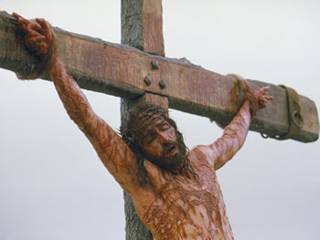
God stepped into our world and intervened on our behalf
You see, at just the right time, when we were still powerless, Christ died for the ungodly. Romans 5:6
He saved us, not because of righteous things we had done, but because of his mercy. Titus 3:5

Slide 11
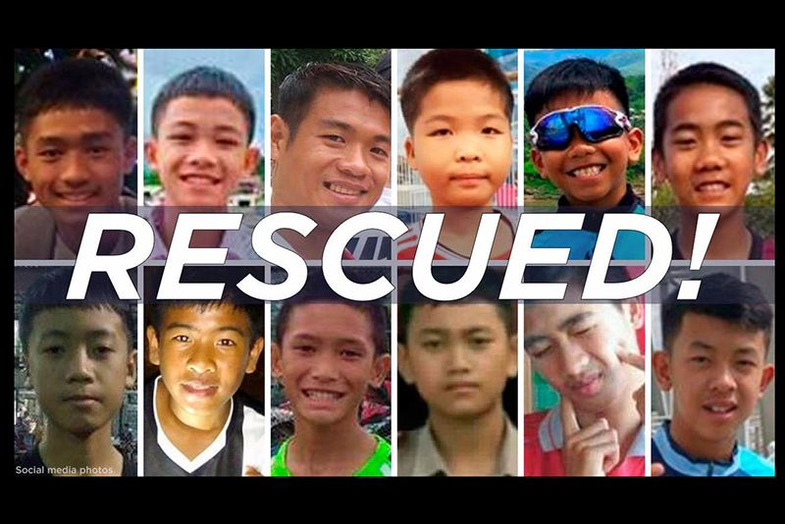
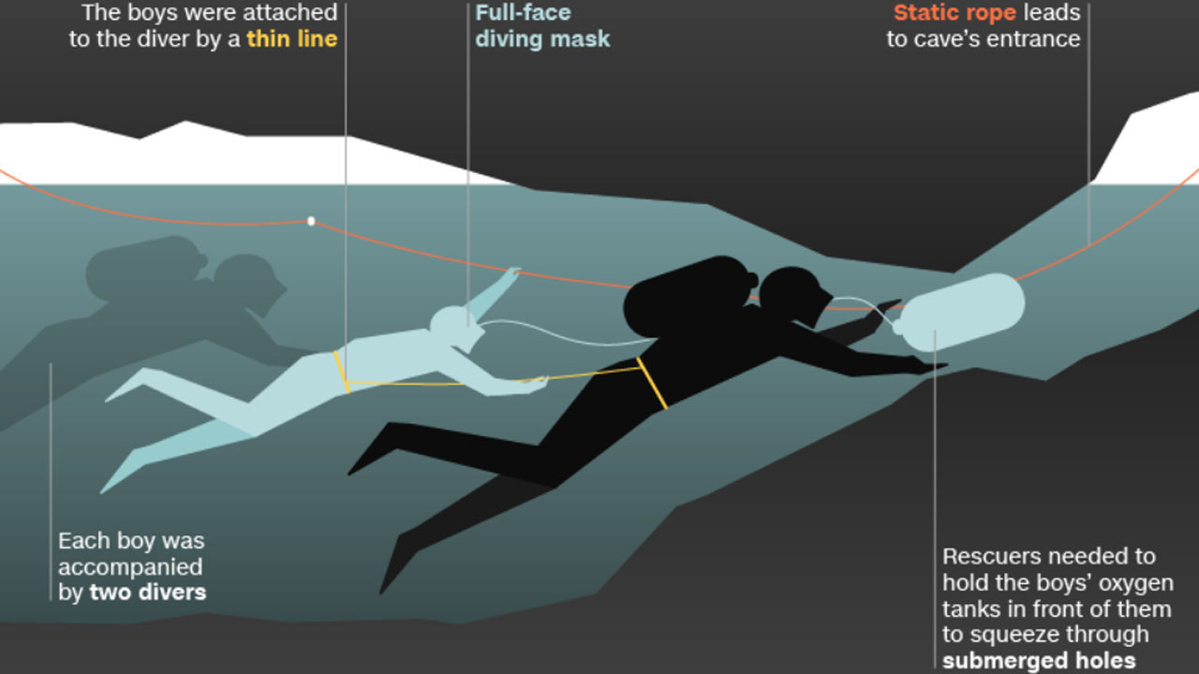
Salvation requires
outside intervention,
surrender,
trust and dependence.
Thailand Cave Rescue 2018

Slide 12
Repent = Turn around - have a change of heart towards God
Repent and be baptised, every one of you, in the name of Jesus Christ for the forgiveness of your sins. And you will receive the gift of the Holy Spirit. Acts 2:38
Repent, then, and turn to God, so that your sins may be wiped out, that times of refreshing may come from the Lord, Acts 3:19

Slide 13
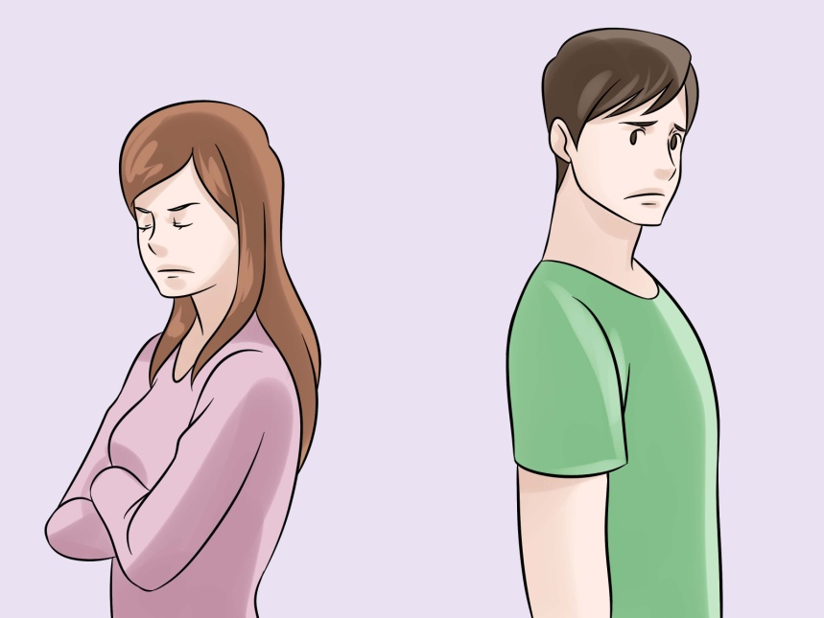
Why do I need to know my sins are forgiven?
Because we were deigned to live in relationship with God, to enjoy His abundant life, and we can’t do that without forgiveness.
No relationship works when one person is out of sorts with the other
Your iniquities have separated you from your God; your sins have hidden his face from you, Isaiah 59:2
If anyone is in Christ, he is a new creation; the old has gone, the new has come! All this is from God, who reconciled us to himself through Christ 2 Corinthians 5:17-18

Slide 14
But how can I be sure of this salvation?
If you confess with your mouth, "Jesus is Lord," and believe in your heart that God raised him from the dead, you WILL be saved. Romans 10:9
"I tell you the truth, whoever hears my word and believes him who sent me HAS eternal life and will not be condemned; he has crossed over from death to life”. John 5:24
If we confess our sins, he is faithful and just and WILL forgive us our sins and purify us from all unrighteousness. 1 John 1:9
He anointed us, set his seal of ownership on us, and put his Spirit in our hearts as a deposit, guaranteeing what is to come.
2 Corinthians 1:20

Slide 15
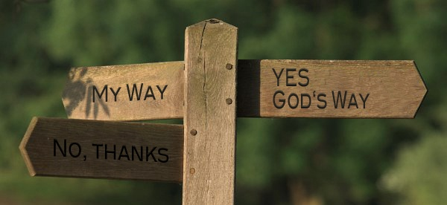
But a choice has to be made
This day I call heaven and earth as witnesses against you that I have set before you life and death, blessings and curses. Now choose life, so that you and your children may live
Deuteronomy 30:19

